Slide 1
Norfolk Lakes Residential Trip
Two-night residential visit to:
Norfolk Lakes Activity Centre
MONDAY 13TH JULY – WEDNESDAY 15TH JULY

Slide 2
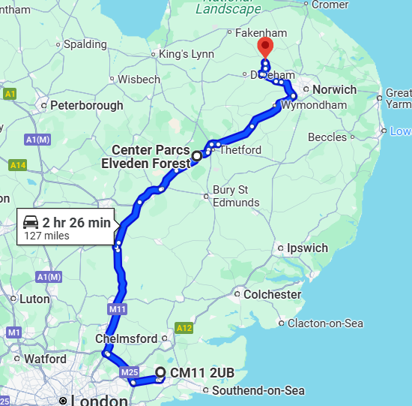
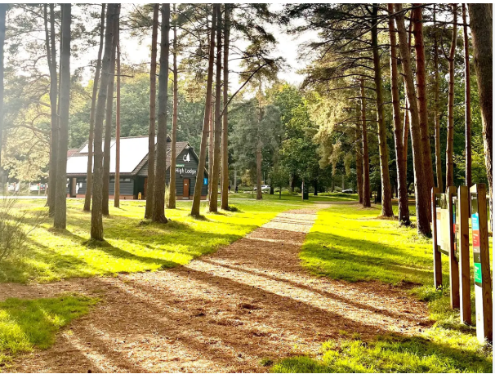
Trip Journey
Lunch at: Center Parcs Elveden Forest, Elveden Forest Elveden Forest Brandon, Thetford IP24 3TR
Norfolk Lakes Activity Centre,
Quarry Ln, Norwich
NR9 5RS

Slide 3
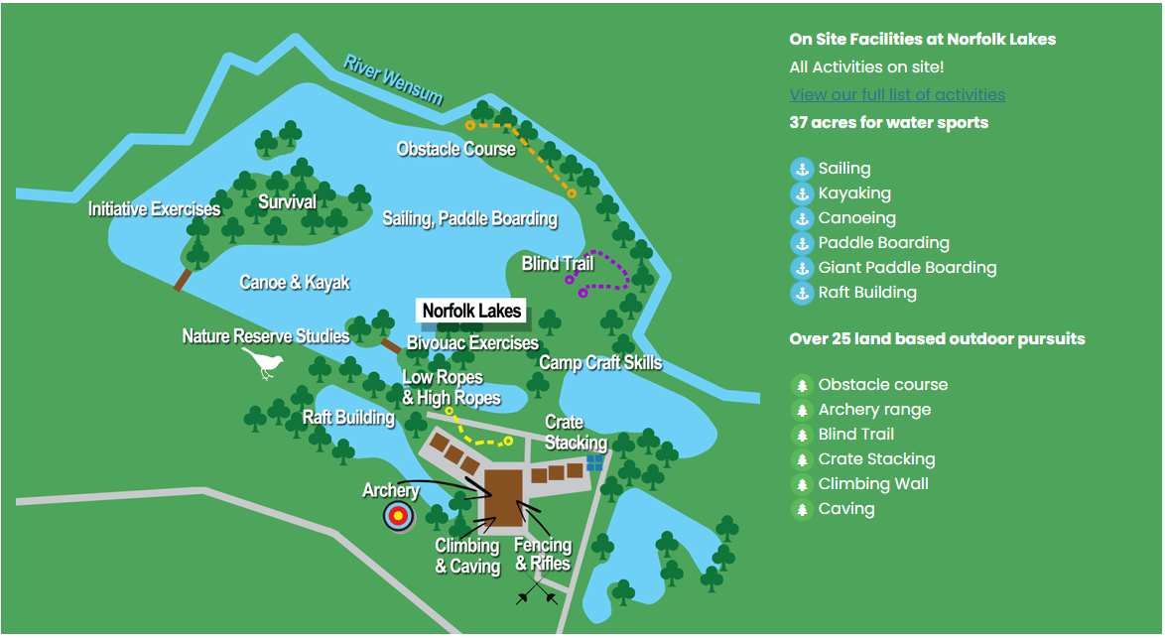

Slide 4
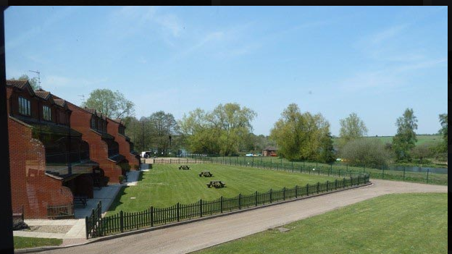

Slide 5

https://vimeo.com/manoradventure/norfolklakes

Slide 6
Day 1: Monday 13th July
8:45: Children to arrive in hall where they will leave their luggage where medicines will be collected.
9.00 – 9.30: Inform the children of groups/rooms.
9.30: Luggage placed on bus.
10.00: Depart school
11.30: Stop for lunch at Thetford.
14.00: Arrive at Norfolk Lakes
14.30 Room allocation and settle in
15.45: Activity 1
17.50: Dinner
19.00-20.30: Activity 2

Slide 7
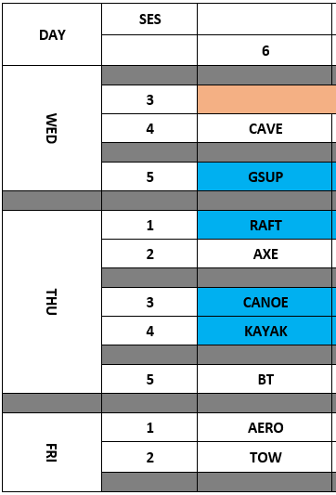
Day 2: Tuesday 14th July
7.40: Breakfast
9.10-10.30: Activity 3
10.45-12.00: Activity 4
12.15-14.00: Lunch
14.00-15.30: Activity 5
15.45-17.15: Activity 6
17.45: Dinner
19.00-20.30: Activity 7

Slide 8
Day 3: Wednesday 15th July
7.30: Breakfast
By 9.00: Adults and Students vacate their rooms, luggage is left in the designated luggage store room.
9.10-10.30: Activity 8
10.45-12.15: Activity 9
12.30: Lunch
Approx. 13.30: Depart.
Approx. 16.00: Arrive at school.

Slide 9
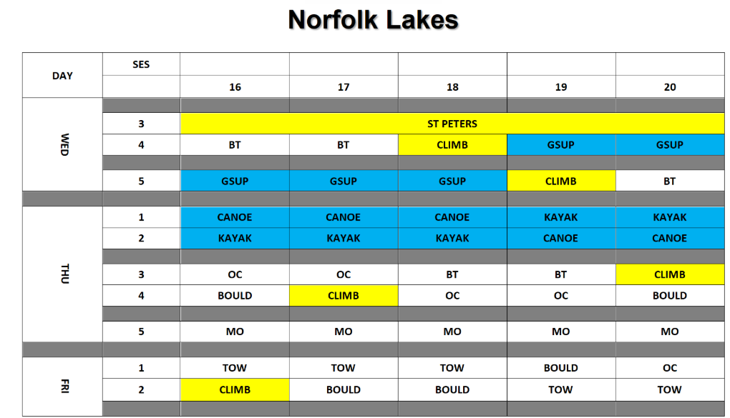

Slide 10
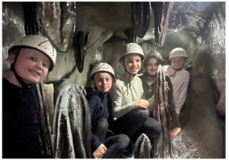
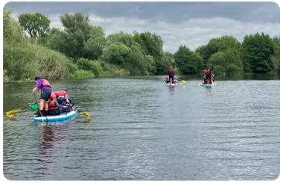
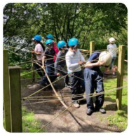
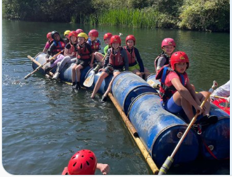
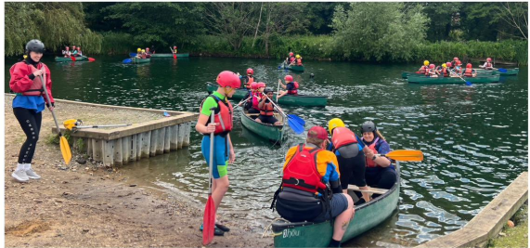
Activities
Giant stand up paddleboarding
Canoe
Kayak
Blind Trail
Obstacle Course
Bould
Manor Olympics
Tug-of-war
Climb

Slide 11
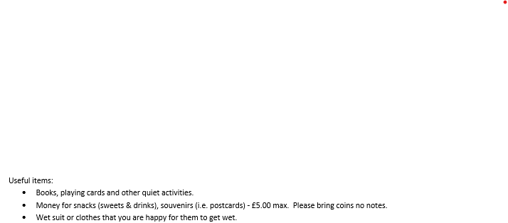
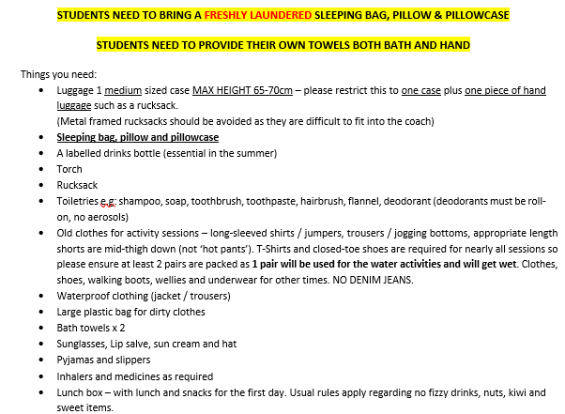
Kit list
Preparing for the Residential
Organise and label clothes in bags according to activities.
Good bedtime routines
No food allowed (excluding lunch on Day 1)

Slide 12
DO NOT TAKE
• Electrical equipment, gaming devices, iPods, MP3 players of any kind!
• Mobile phones / cameras
• Expensive/unnecessary clothing, make up, jewellery
• Chewing gum
• Aerosol spray deodorant – health and safety hazard!
• Wellies
• Denim jeans are not ideal for outdoor use
Please label EVERYTHING you bring with you.
Mobile Phones
No mobile phones please. A Parentmail will be sent to parents to inform them we have arrived safely, and, if necessary, on the way home, to inform of any delays.

Slide 13
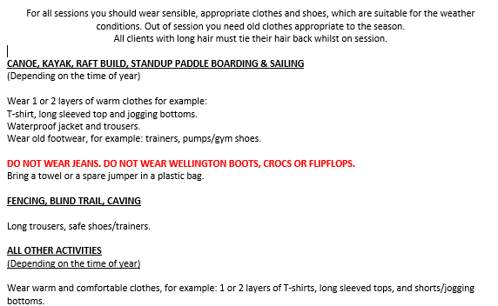
What to wear on sessions

Slide 14
Medical/ Dietary Requirements
Please ensure most up to date information is shared with the office.
Parentmail form for medical consent which requires NHS number & tetanus details, emergency contacts numbers etc. To return by Monday 29th June
We will organise individual meetings where necessary.
If anyone in your party is recovering from a recent injury, (within 3 months for upper body limb & 6 months for lower body limb) fracture or operation they must have a ‘clean bill of health’ from their GP/Consultant and written notification from their parent / carer sent to the activity centre to say that the individual is fit and healthy with no existing conditions that may affect participating in activities i.e. wearing a harness, getting wet etc.

Slide 15
Photos
We will update Twitter regularly to keep parents updated.
If your child does not have permission to have photos taken in school, we will not include them in any of the photos on Twitter.
Please inform the office if you would like to make any amendments for the trip.

Slide 16
Adults
6 Members of Staff will be accompanying the children on the trip
Mrs Walker
Mrs Bradbury
Miss Dewey
Miss Tucker
Miss Smith
Miss Morris

Slide 17
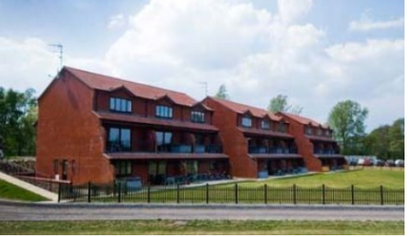
Groups and
Sleeping Arrangements
Groupings have been made from the names of the three children selected by each child – they are guaranteed to be with at least one person on their list
Groups Approx 1 adult: 10 children
Sleeping arrangements : Boys and Girls separate rooms
2 adults in each apartment.

Slide 18

Safety
Reminders of behaviour
expectations at home
and in school.
Contact with school throughout
the week.
St Peter’s Risk Assessment
Norfolk Lakes Risk Assessment

Slide 19
From the office:
The deposit payment of £50 must be paid by Friday 12th June.
This is done via Arbor Trips.

Slide 20
Questions
We are available now to answer any questions that you may have.

